Slide 1
Predicting Substance Abuse
Matthew Heinen Bellevue University DSC 680: Applied Data Science

Slide 2
Predicting Substance Abuse – Difficult Task, High Consequences.
Substance abuse is widespread and challenging to diagnose.
Medical professionals miss over 70% of cannabis abuse cases in a clinical setting.
Undetected cases strain families, hospitals, and public resources.
Opioid use cost the US economy over $1 trillion in 2017.
A predictive model can help medical staff and families identify likely substance abuse cases for earlier intervention.
Better health outcomes.
Revenue potential for hospital and resource networks.

Slide 3
Data - Substance Abuse and Mental Health Services Administration
7 million+ patient records
40 features per record
Includes age, race, employment, region, mental health history
Engineered Target Variable
Substance abuse diagnosis flag

Slide 4
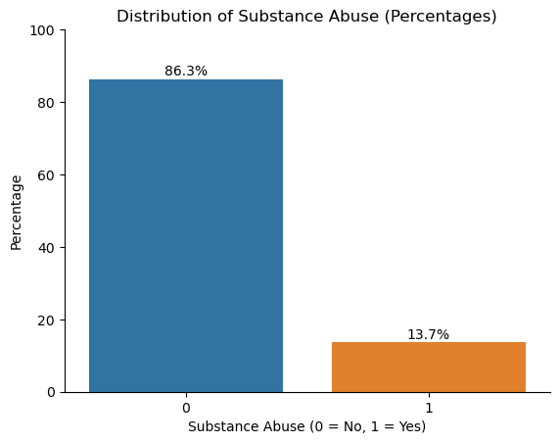

Slide 5
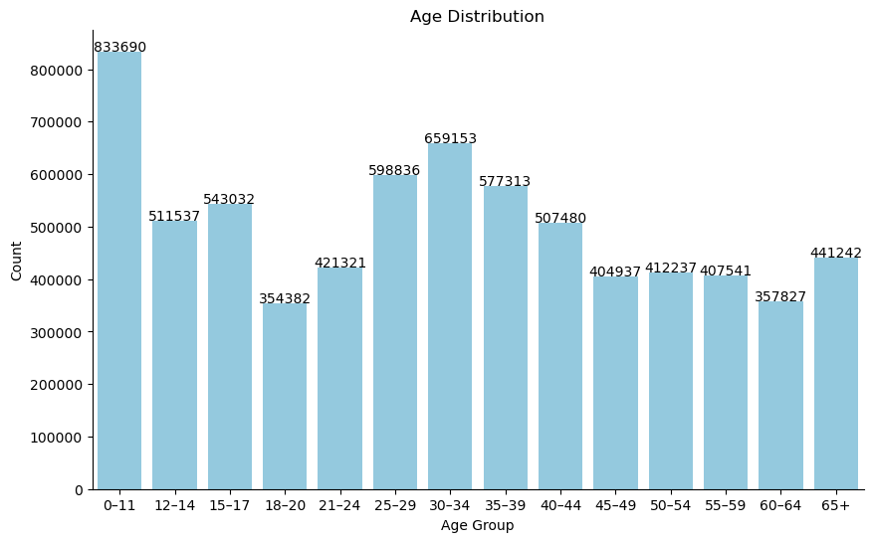

Slide 6
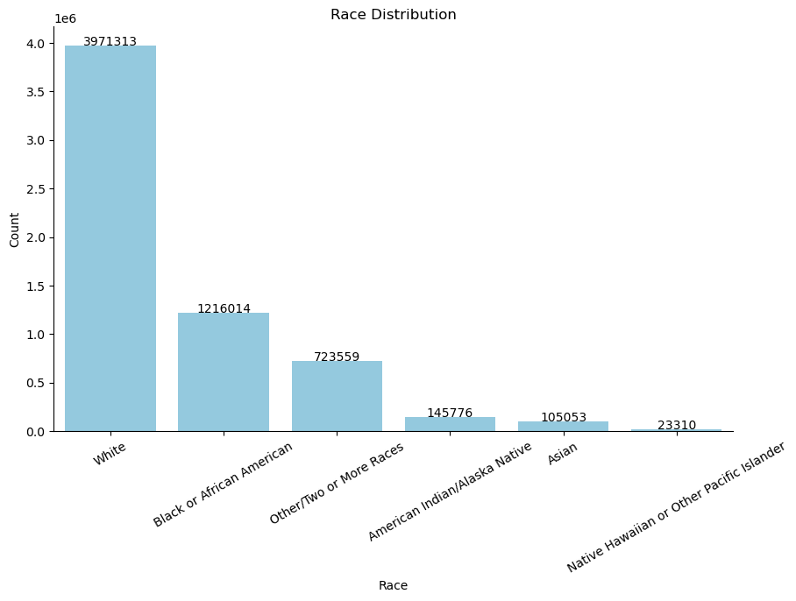

Slide 7
Methods
Target Variable:
Engineered from substance abuse diagnosis flag ("SUB")
Models Tested:
Logistic Regression
Decision Tree
Random Forest
Gradient Boosted Trees
MLP Neural Network
Training Approach:
Grid search for hyperparameter optimization
80/20 train-test split to reduce overfitting
Evaluation Metric:
F2 Score (maximizes true positives and recall)
Decision tree selected: Test accuracy 90.1%, F2 score 0.55

Slide 8
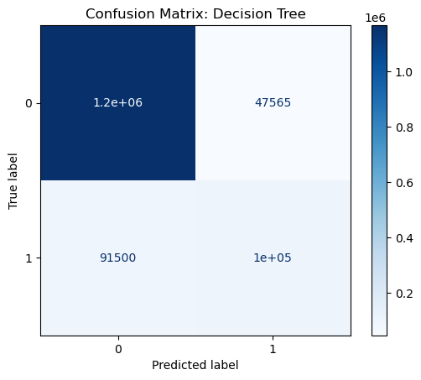

Slide 9
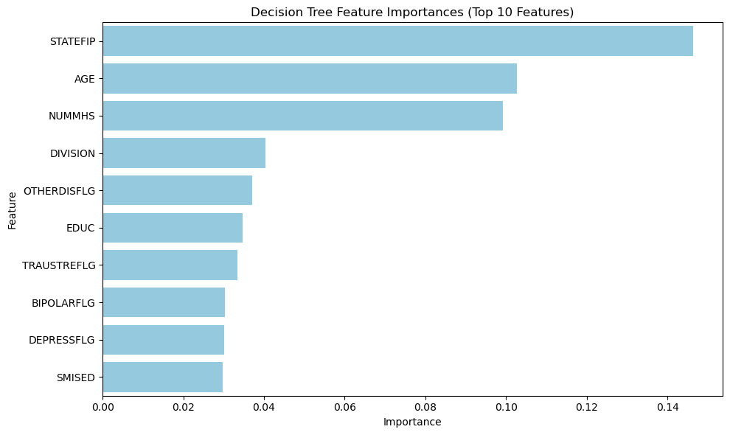

Slide 10
Implementation, Limitations and Ethical Considerations
Recommended implementation for helping diagnose substance abuse.
Use in hospitals/clinics for screening patients- allowing providers to be more alert.
Online tool for families to assess loved ones.
Limitations
Data only from SAMHSA-funded hospitals—may not apply to other settings
Requires accurate previous health care information.
Ethical Considerations
Model maximizes true positives: risk of false positives exists
False diagnosis can impact emotional and financial well-being
False Negatives
Patients will not receive the treatment they need.

